Slide 1



Public Policy for Net-Zero Homes and Affordability
Policy Recommendations
July 18, 2023

Slide 2
Starting points
The urgency of the climate crisis cannot be overstated.
  Massachusetts (and beyond) must immediately decrease carbon emissions from the residential building sector with a goal of net-zero carbon emissions.
  The stretch energy code and the specialized stretch energy code are positive steps towards that goal and more remains to be done.
The crisis of housing affordability is also urgent.
  The cost of the median home in Massachusetts is the third highest in the nation.
  1 out of 4 renters and 1 out of 10 homeowners in Massachusetts are paying more than half of their income to housing costs.
We need additional strategies that can decrease carbon emissions and advance affordability simultaneously.

Slide 3
Research Questions
The intersection of net zero and housing affordability
  How does the increased cost (if any) of meeting the new stretch code (as of July 2024) and opt-in specialized stretch code (currently) relative to the current base code affect the affordability of newly built housing?
  What are the policy tools that can help simultaneously advance the transition to net-zero housing while also addressing the housing affordability crisis?

Slide 4
Affordability Analyses
Affordability = Total housing costs / Household income
Housing costs generally include either
  (1) rent + utilities or
  (2) mortgage principal and interest + property taxes + property insurance + utilities
  Increased construction cost estimate from WIT
MassSaves All-Electric Single Family Incentive
Component | Level 1 | Level 2
Energy savings percentage or HERS Index Score | Savings ≥ 30% or HERS Index Score ≤ 45* | Savings ≥ 50% or HERS Index Score ≤ 35*
Heat pump for space heating † | Required | Required
Heat pump for water heating | Optional | Required
All-electric cookware | Required | Required
Infiltration rate (ACH) | ACH50 ≤ 1.5 | ACH50 ≤ 1.0
Balanced ventilation systems (HRVs & ERVs) | Required | Required
Continuous envelope insulation ‡ | Optional | Required
Electric vehicle-ready checklist | Required | Required
 | $15,000 | $25,000

Slide 5
Affordability Analyses: Energy Costs
How do the new energy efficiency requirements affect energy costs?
  Energy costs represent 7 percent of the monthly housing costs for homeowners in Massachusetts.
  Analysis of the RESNET data on HERS scores and estimated energy costs in Massachusetts suggests substantial declines in energy costs:
  For the median owner of a single-family home built in Massachusetts since 2010, that would be an estimated savings of $48 per month, while for the median renter of a home built in Massachusetts since 2010 that would be an estimated savings of about $1 per month at HERS 42 or $30 per month at Passive House standards.

Slide 6
Affordability Analyses Combined
There is substantial uncertainty about the estimates of costs and savings given fluctuation in energy prices and the costs of materials and labor. Analyses are based on data from the U.S. Census American Community Survey Individual Public Use Micro-Data Sample.
The effects on the ability to buy or rent a newly built home are felt most by homebuyers and renters with incomes between roughly 30 and 70% of the state income distribution, before taking into account any existing incentives.
Additional Monthly Homeowner Costs/Savings |  | Additional Monthly Renter Costs/Savings
Additional mortgage costs | +$94 | Additional rent | +$43
Additional taxes + insurance costs | +$13
Energy cost savings | -$48 | Energy cost savings | -$30
Total | +$59 | Total | +$12

Slide 7
Policy Tools: Land Use Changes
Improvements to local land use policy could reduce carbon emissions and improve affordability.
  Other states have taken statewide action to facilitate more affordable and climate friendly land use policies (e.g. Maine, Oregon, California, etc.)
  Improvements could include
    Smaller minimum lot sizes
    Larger height limits
    More multifamily construction by right
    Density bonus for more energy efficient multi-family housing

Slide 8
Policy Tools: Streamlining Permitting
Streamlining state and local permitting
  Waiver of local special permits for more energy-efficient buildings
  Process similar to Chapter 43D expedited local permit process
Reducing utility connection delays
  U.S. Department of Energy’s SunShot Initiative Rooftop Solar Challenge

Slide 9
Policy Tools: Restructuring Financial Incentives
Create a Building Decarbonization Clearinghouse
  Single point of contact
  Streamlined application process for
    MassSave, Massachusetts Clean Energy Center incentives, Solar Massachusetts Renewable Target (SMART) rebates, Alternative Portfolio Standards, Renewable Portfolio Standards, etc.
  Incentives for builders and homeowners
Restructure financial incentives to include
  Longer duration commitment to availability given long development timelines
  Statewide application

Slide 10
Policy Tools: TA and Underwriting
Technical assistance
  New programs for smaller builders modeled on Massachusetts Clean Energy Center’s Passive House Design Challenge
  Education, training, and workforce development for design and construction professionals
Real estate agents, appraisers, and underwriters
  Require Green Designation for real estate brokers
  Require Residential Green and Energy Efficient Addendum and support their use
  Improved guidance from GSEs on how to take energy efficiency into account for appraisal and underwriting

Slide 11
Policy Tools: Green Bank
Massachusetts Community Climate Bank
  Use public funds to catalyze larger private investments, reduce financing costs for energy efficient construction
  Aggregate small, decentralized projects
  Provide credit enhancements through loan loss reserves or guarantees
  Provide below market-rate loans through revolving loan funds
  Invest directly in energy-efficient affordable housing development
  Make the most of the Inflation Reduction Act Greenhouse Gas Reduction Fund

Slide 12
Public Policy for Net-Zero Homes and Affordability
Cost Implications
July 18, 2023

Slide 13

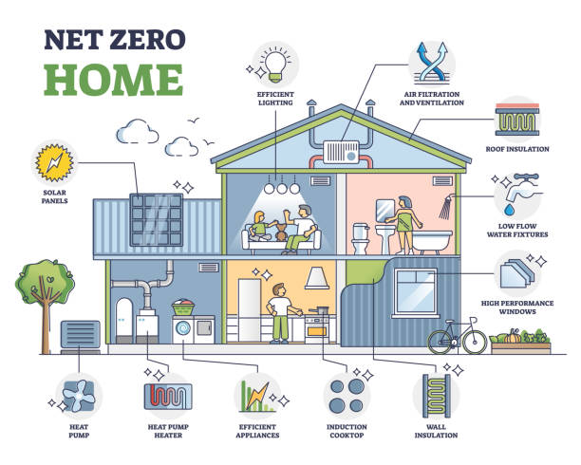
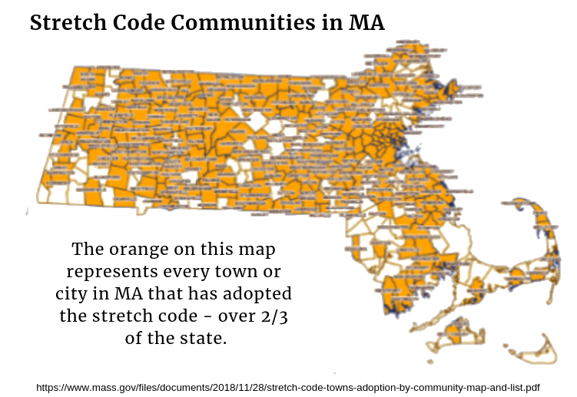
Overarching Questions
In Massachusetts, how do the costs of building net zero and net zero ready homes compare to similar conventional homes built to the current building code?
How do the costs compare for projects of different sizes, including single family and multi-family developments?

Slide 14

Research Methodology
Literature review for the cost calculation
Interview with builders, architects, consultants, and other stakeholders
Three different typologies
    Single Family,
    Small Multi-Family (1-4 Units), and
    Large Multi-Family (5+ Units)
Creating model buildings
Energy modeling and manual J calculations
Obtaining quotes from subs

Slide 15

Categories of Energy Modeling Analysis for
Single and Small Multi-family

Slide 16

Single Family Model Homes

Slide 17
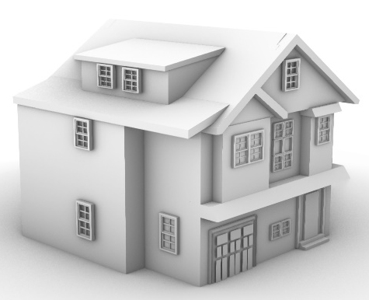
Single Family Model Home & General Parameters

Slide 18
Specifications of Single-family Model Home for
4 Different Scenarios

Slide 19
Single Family Model Homes:
Construction Cost Differences for All Scenarios Compared to the Single-Family Base Model Home (HERS 55)

Slide 20
Single Family Model Homes:
Construction Cost Differences for All Scenarios Compared to the Single-Family Base Model Home (HERS 55)

Slide 21

Small Multi-Family Model Homes

Slide 22
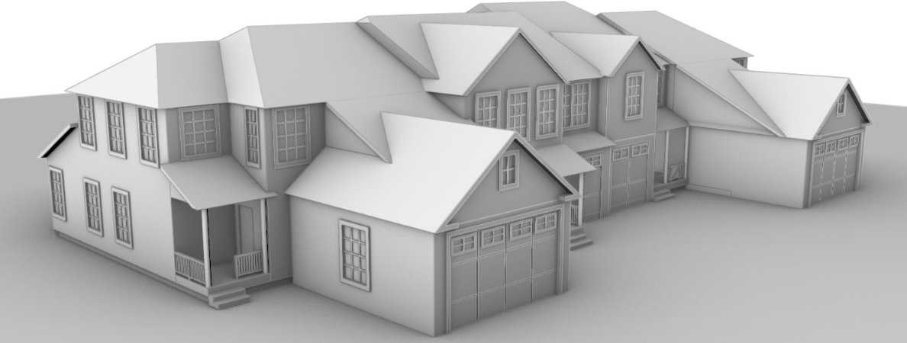
Small Multi-Family Model Home

Slide 23
Small Multi-Family Model Home: General Parameters

Slide 24
Specifications of Small Multi-family Model Home for
4 Different Scenarios (Unit #1, 4)

Slide 25
Small Multi-Family Model Homes:
Construction Cost Differences for All Scenarios Compared to the Small Multi-Family Base Model Home (HERS 55)

Slide 26
Small Multi-Family Model Homes:
Construction Cost Differences for All Scenarios Compared to the Small Multi-Family Base Model Home (HERS 55)

Slide 27

Large Multifamily

Slide 28
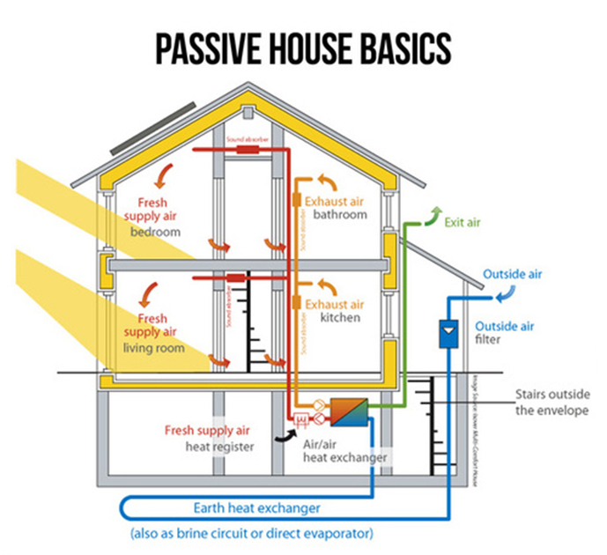
Approach
New round of interviews
Cost delta analysis on under construction or recently completed large multifamily projects in MA that are PH certified or expected to be certified.
Find statistically significant number of projects to strengthen the results
PHIUS report ➔ an increase of 2-4% premium potentially for experienced Passive House contractors, and +5-10% for first time Passive House contractors.

Slide 29
Large Multi-Family Model Homes:
Cost delta for large multi-family projects
(Conventional vs. Passive House)

Slide 30
Acknowledgement
We thank all of the people and companies who contributed in some way to the work described in our report by sharing their experience and expertise.

Slide 31

Questions?
Thank you!

